Slide 1

Chicago CRIME
Sue Young, Teodora Latinska and Tricia Miller
A MACHINE LEARNING EXPLORATION

Slide 2
The PROBLEM
Most crimes in the city of Chicago go unsolved according to the Pew Research Center. ¹
Using Machine Learning can assist to determine resolution (arrest or no arrest) of reported crimes.
The StAKEhOLDErs
Target Clients: police departments in the city of Chicago, lawmakers, city planners, correctional facilities and a multitude of other actors who are affected by the number of arrests in the city.
Predicting whether a crime resulted in an arrest could help decision makers determine the most likely conditions that could result in future arrests and thus make contingency plans for mitigating the conditions that cause the likelihood to go up, not only making neighborhoods safer, but also planning for police staffing needs, correctional facility needs, and other.

Slide 3
The DataSet
Initial Dataset
Data was obtained from the City of Chicago Data Portal
Data spanned from 2016-2019 and contained over 1 million records
Building a Manageable Dataset
Used 2016-2018 as model training data
Removed unwanted columns
Label and one hot encoded non-numerical columns
Data Analysis Focus
Map visualization of crime occurrence
Total recorded crimes that resulted in arrests and non-arrests
Top ten overall crime types by count and percentage of arrests
Top ten crime types by highest arrest percentage

Slide 4
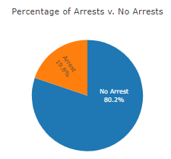
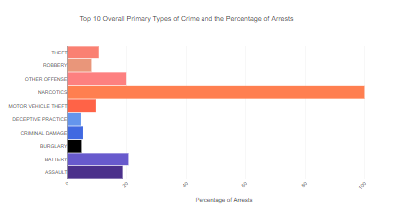
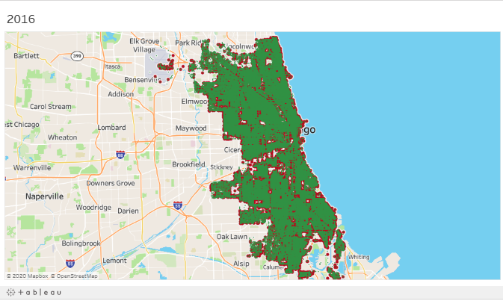
Data Visualization

Slide 5
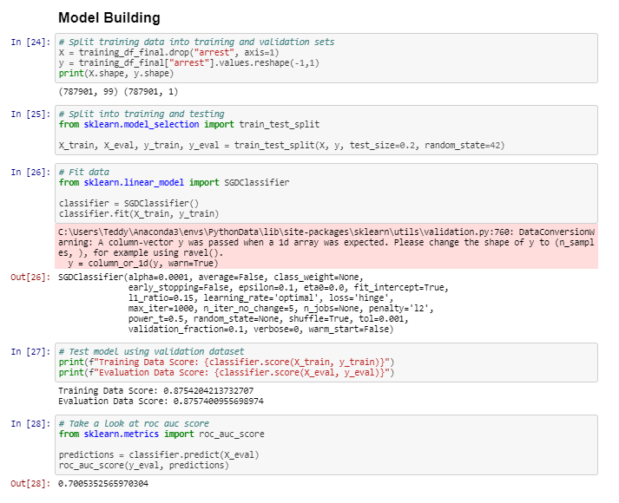
MACHINE LEARNING
Used sklearn in Jupyter Notebook to fit and test model
Trained model on 2016-2018 crime data. Binary target variable: arrest or no arrest
Three models trained: Random Forest, SGD Classifier, Linear SVM
Different features used in each model

Slide 6
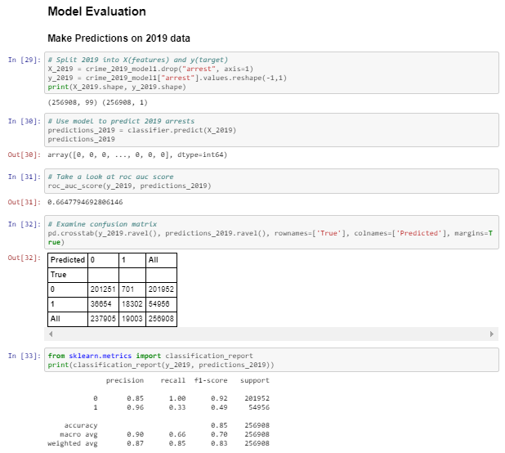
MACHINE LEARNING
Tested model on 2019 crime data. Binary target variable: arrest or no arrest
Output classification report to compare model performance
Use of other models and their accuracy assessments can give more insight into best features for model training

Slide 7
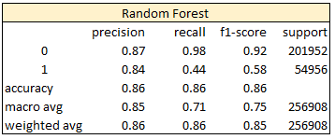
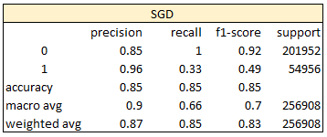
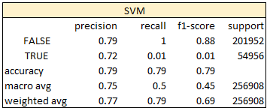
MACHINE LEARNING: RESULTS
All models much better at labeling crimes that did not result in arrest as non-arrest than those that did result in arrest as arrest
All models classified less than 50% of true arrests as arrests, but classified virtually 100% of true non-arrests as non-arrests
All models had weighted average precision greater than 75%, meaning that for all instances classified one way or the other, based on the weighted occurrence of each class, they were correct more than 75% of the time

Slide 8
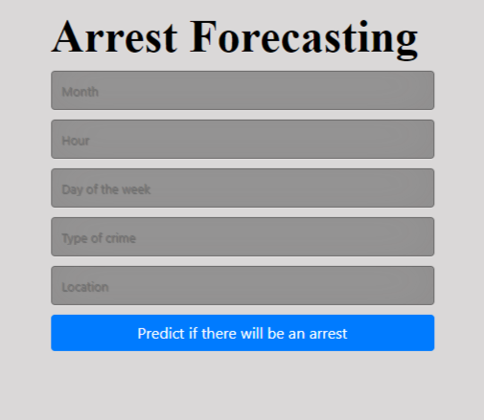
MACHINE LEARNING: PreDICT
For our prediction page, we used Multi-layer Perception (MLP), which is a supervised machine learning algorithm that trains by using non-linear, hidden layers. Each layer trains by input from the previous layer.
We scaled down the features used in this model to 5 make it easier for user input to demonstrate how the machine predicts.
The five features used in this model are
Month
Hour
Day of the week
Type of crime
Location

Slide 9
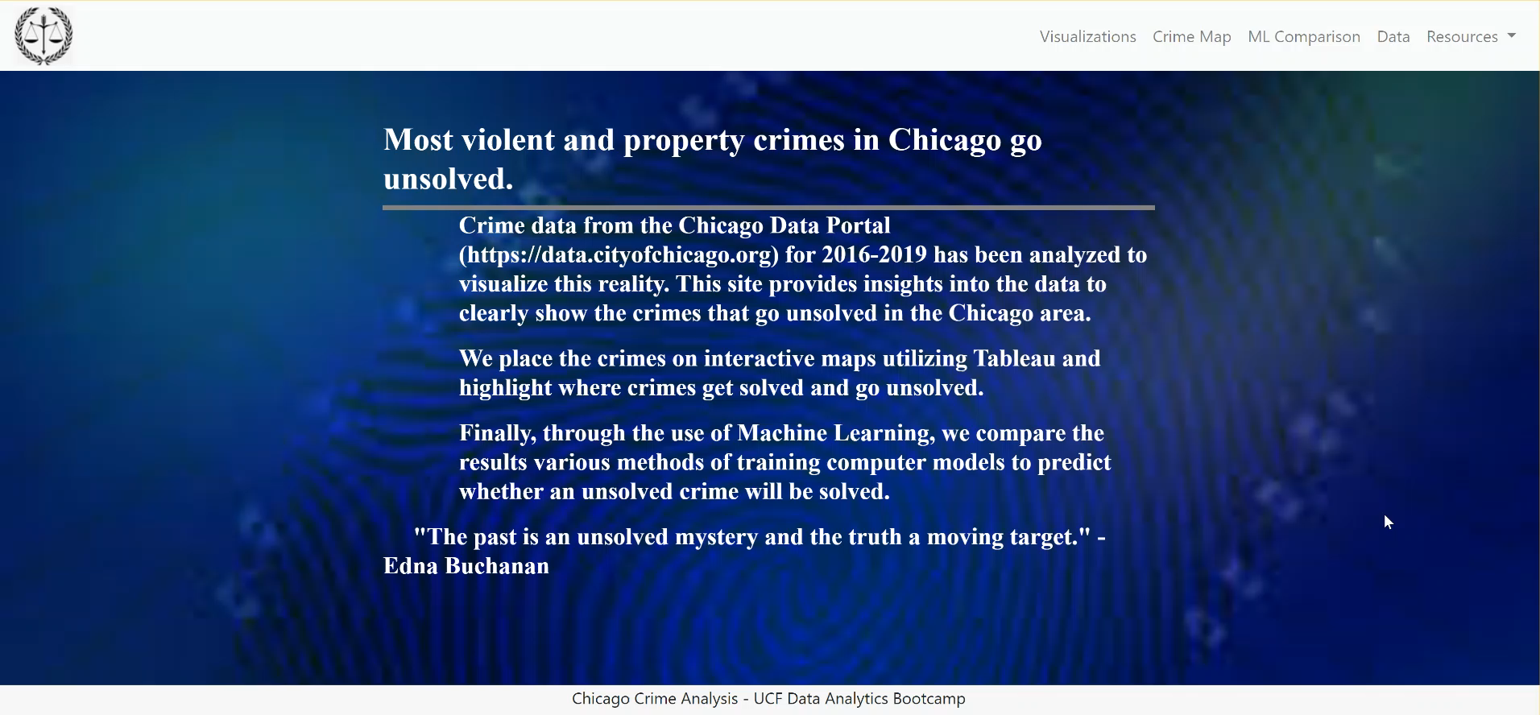
Demonstration

Slide 10
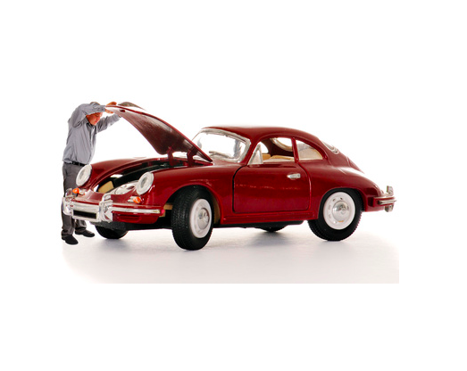
Under the hood
Python
Pandas
Sklearn
Plotly
Tableau
Jquery
Bootstrap
D3
HTML
CSS

Slide 11
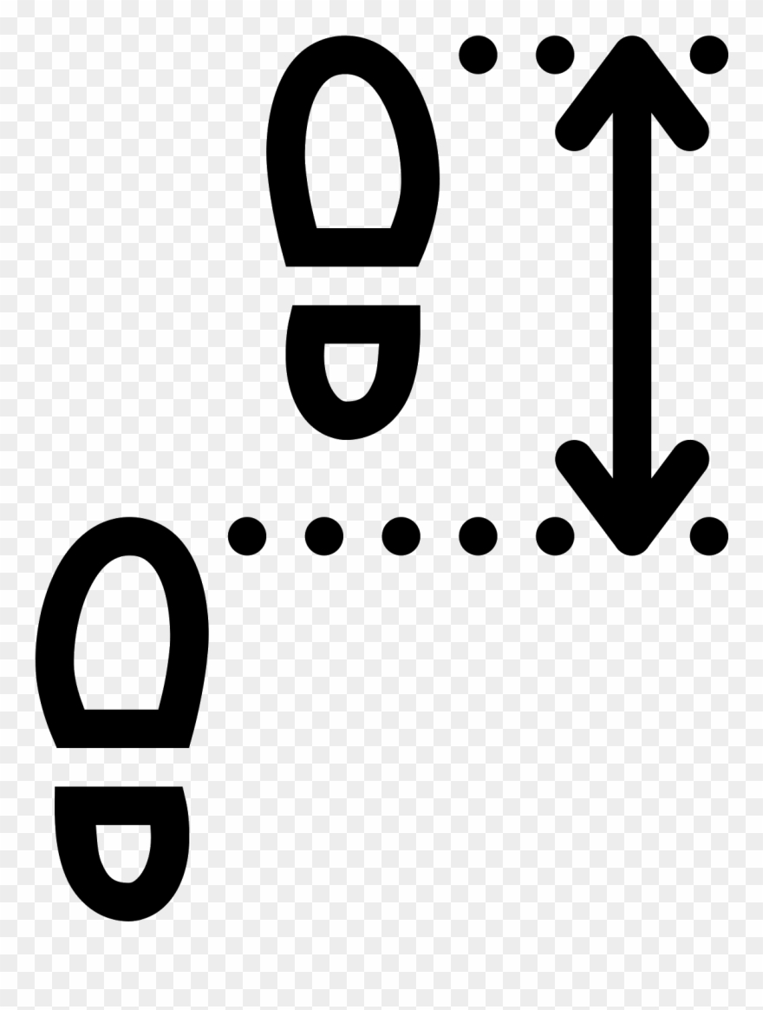
Next steps
Test other classifier models
Perform more feature engineering and feature transformation
Consider further evaluation metrics
Build web functionality to be able to input features and get results of given model

Slide 12
Questions

